Slide 1
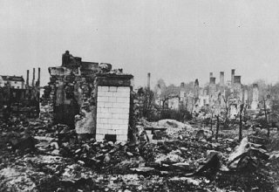
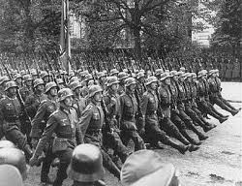
Invasion of Poland
September 1, 1939, Nazi forces invaded Poland.
September 3, 1939 Britain and France declared war on Germany.
A Polish city in ruins
German troops parade through Warsaw
Notes:
Picture on the right: German troops parade through Warsaw after the surrender of Poland. September 28-30, 1939.
Picture on left: Germand troops appraoch Bydgoszcz Poland Sept. 18, 1939

Slide 2
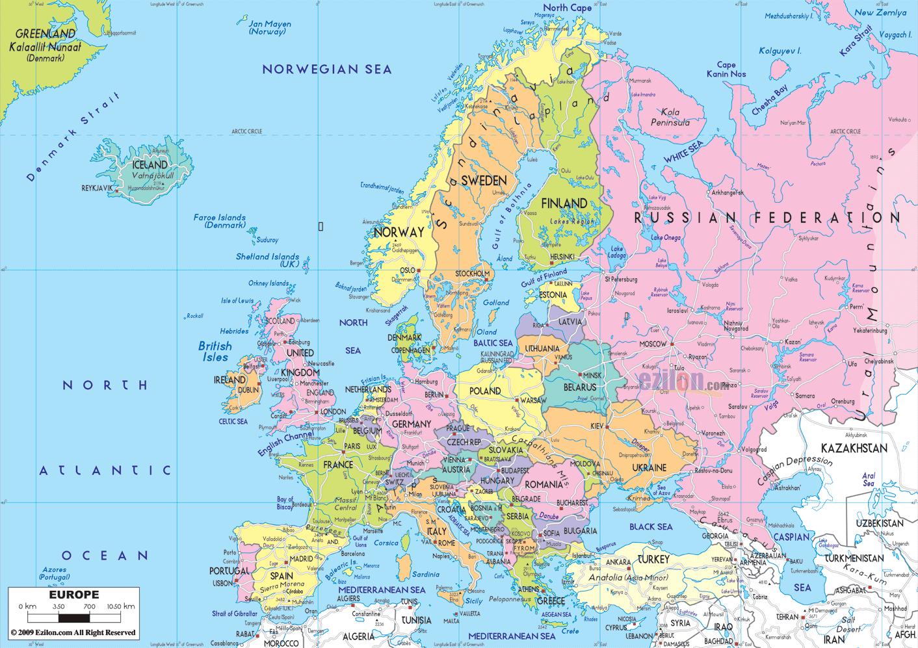
Where is Poland?

Slide 3
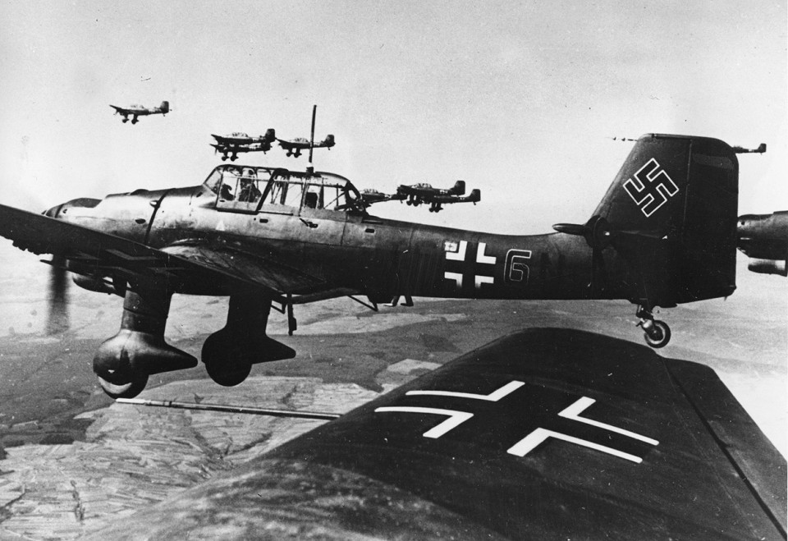
Blitzkrieg
“Lightning War”
First German planes and dive bombers devastated the area.
Then fast-moving tanks and troop transports roared into the country.
WWII was the first war to use airplanes in large-scale attacks. What was mainly used in WWI?
German Stuka dive bombers fly over Poland

Slide 4
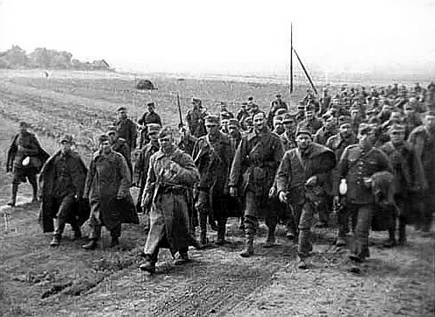
Nazi-Soviet Pact
Germany attacks from the west
Stalin’s forces invaded from the east, grabbing lands promised to them under the Nazi-Soviet Pact.
Polish prisoners of war captured by the Red Army
Notes:
Germany and the Soviet Union had a weird relationship. Nazi’s do not like Communism but Hitler was willing to cooperate with them to get what he wanted. They sign a pact agreeing to trade and a nonaggression pact. This allowed Germany to attack Poland without fear of Soviet intervention. The nonaggression pact secretly allowed them to divide Poland between them. Eventually they again attack the USSR.

Slide 5
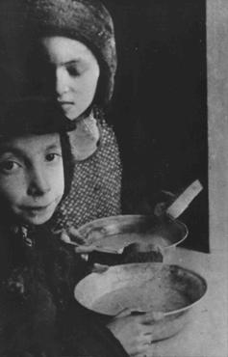
Ghettos in Poland
The Germans forced Jews to live in marked-off sections of cities called ghettos.
Usually enclosed by barbed-wire fences or walls, with entrances guarded.
Curfews
Jewish children eating soup in Warsaw ghetto.

Slide 6
Charlene Schiff
http://www.ushmm.org/wlc/en/media_oi.php?MediaId=1110
Charlene's town was in the part of eastern Poland occupied by the Soviet Union under the German-Soviet Pact of August 1939. The Germans invaded the Soviet Union in June 1941, and arrested Charlene's father after they occupied the town. She never saw him again.
Charlene, her mother, and sister were forced into a ghetto but fled in 1942. Charlene and her mother hid in underbrush at the river's edge, and avoided discovery by submerging themselves in the water for part of the time. They hid for several days. One day, Charlene awoke to find that her mother had disappeared. Charlene survived by herself, and was liberated by Soviet troops.

Slide 7
William (Welek) Luksenburg
http://www.ushmm.org/wlc/en/media_oi.php?MediaId=1231
Shortly after the German invasion of Poland in September 1939, William's family was ordered into a ghetto and his brother went to a work camp. William bribed officials to discharge his brother from a hospital destined for evacuation to Auschwitz. Later, after escaping from a prison camp to tend to his brother, William was jailed. William collapsed during a death march near the Austrian border, but was then liberated. His parents and brother perished.

Slide 8
Blanka Rothschild
http://www.ushmm.org/wlc/en/media_oi.php?MediaId=1097
After the German invasion of Poland, Blanka and her mother were forced into the Lodz ghetto in 1940 where they remained until late 1944 when they were deported to the Ravensbrueck camp in Germany. Blanka was forced to work in an airplane factory (Arado-Werke). Her mother was sent to another camp. Soviet forces liberated Blanka in spring 1945. Blanka, living in abandoned houses, made her way back to Lodz. She discovered that none of her relatives, including her mother, had survived. Blanka then moved westward to Berlin, eventually to a displaced persons camp.

Slide 9
Benjamin (Ben) Meed
http://www.ushmm.org/wlc/en/media_oi.php?MediaId=1095
After the Germans occupied Warsaw Ben was assigned to a work detail outside the ghetto, and helped smuggle people out of the ghetto. Later, he went into hiding outside the ghetto and posed as a non-Jewish Pole. During the Warsaw ghetto uprising in 1943, Ben worked with other members of the underground to rescue ghetto fighters, bringing them out through the sewers and hiding them on the "Aryan" side of Warsaw. After the uprising, Ben escaped from Warsaw by posing as a non-Jew. Following liberation, he was reunited with his father, mother, and younger sister.

Slide 10
German Victory Parade in Warsaw
http://www.ushmm.org/wlc/en/media_fi.php?ModuleId=10005070&MediaId=237
How do the Germans look?
How could the German government use this footage?

Slide 11
Closure
Which personal account was the most interesting to you and why?

