Slide 1
The Brain: True or False
1.The left side of the brain controls the left side of the body and the right side of the body controls the right side of the body.
2.Rage, pleasure, hunger, thirst and sexual desire are all controlled by the same part of the brain.
3.Electricity runs through our brain cells.
4.Males and females both have male and female hormones in their bodies.

Slide 2
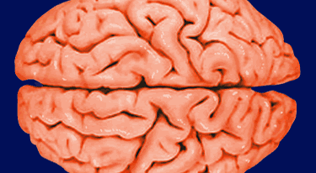
Are you right or left brain?
Take the quiz.
Tally your results.
Let’s test it, watch this video.
Which way is she turning? Clockwise or Counterclockwise

Slide 3
The Brain
Oprah Holds a Brain Video Clip

Slide 4
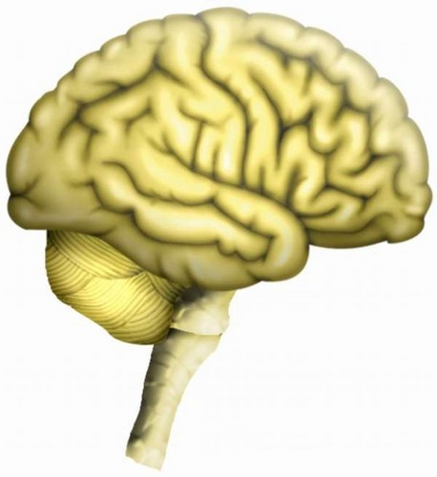
The Brain
Cerebral Cortex – wrinkly outer layer of the brain
All the folds = more brain mass!

Slide 5
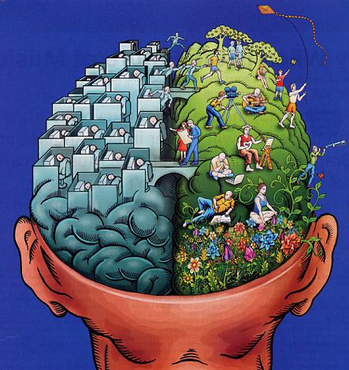
The Brain
Brain divided into two halves called hemispheres!
Fissure – gap between the two brain hemispheres
Left hemisphere controls right side of the body. Right hemisphere controls left side.

Slide 6
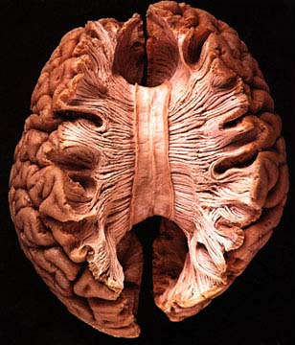
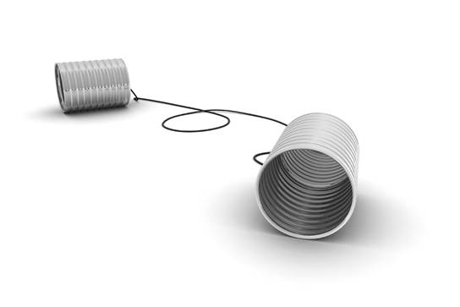
The Brain
Corpus Callosum – fibers connecting the two hemispheres

Slide 7
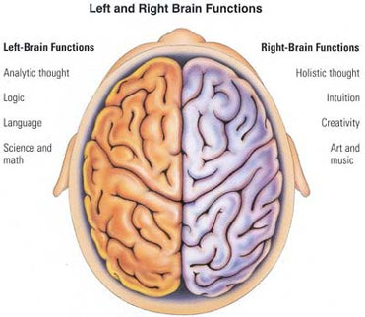
The Brain

Slide 8
Video Clip
Right Brain Thinking

Slide 9
The Brain
Women have larger corpus callosums then men. So are they better balanced between the two hemispheres and can multitask better?

Slide 10
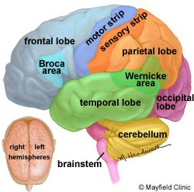
The Brain
Lobe – a section of the cerebral cortex
The brain looks like a boxing glove!

Slide 12
The Brain
Frontal Lobe – makes up the front of the brain
The fingers of the boxing glove!

Slide 13
The Brain
Prefrontal Area – where we re-experience past events or “picture” ourselves in the past

Slide 14
The Brain
Frontal Association Area – complex thinking, decision-making and personality

Slide 15
The Brain
Broca Area – in charge of speech production

Slide 16
The Brain
Motor Strip – controls movement

Slide 17
The Brain
Parietal Lobe – makes up the middle part of the brain
The back of the hand of the boxing glove!

Slide 18
The Brain
Sensory Strip – controls sensation

Slide 19
The Brain
Occipital Lobe – makes up the back of the brain
organizes visual information
The wrist of the boxing glove!

Slide 20
The Brain
Temporal Lobe – makes up the bottom of the brain
controls hearing and speech
The thumb of the boxing glove!

Slide 21
The Brain
Wernicke Area – understands written and spoken language

Slide 22
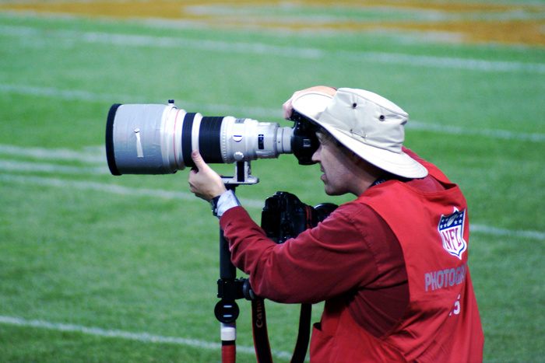
The Brain
Name that Lobe!

Slide 23
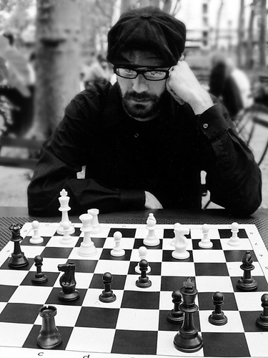
The Brain
Name that Lobe!

Slide 24
The Brain
Name that Lobe!

Slide 25
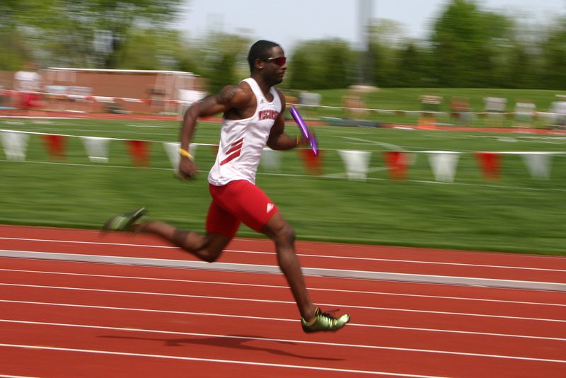
The Brain
Name that Lobe!

Slide 26
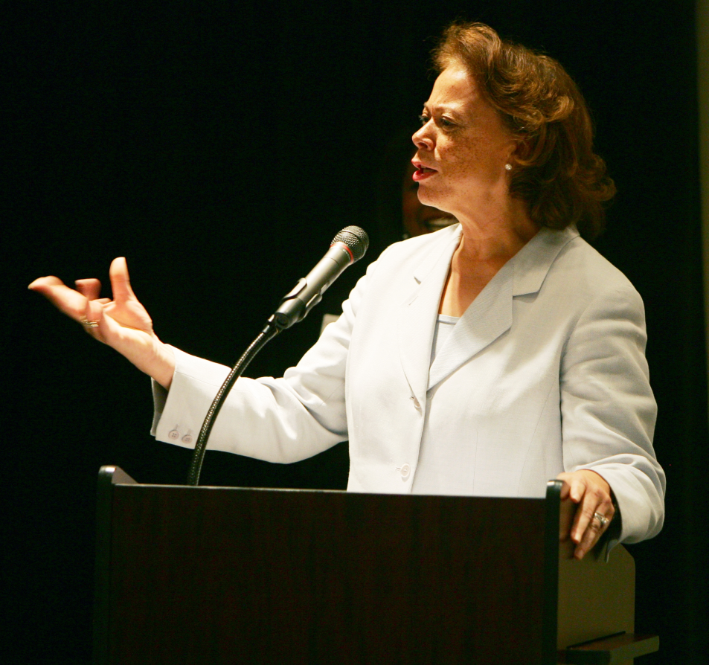
The Brain
Name that Lobe!

Slide 27
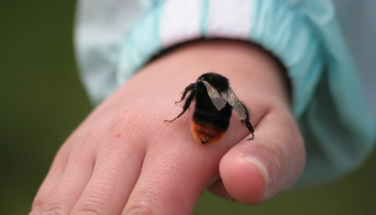
The Brain
Name that Lobe!

Slide 28
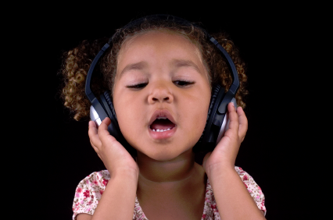
The Brain
Name that Lobe!

Slide 29
The Brain
Color each lobe
a different
Color.

Slide 30
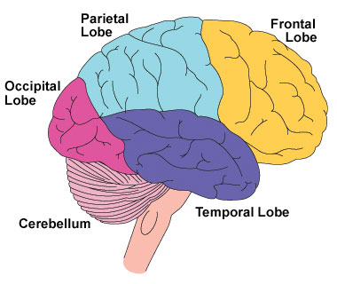

Slide 31
